Slide 1
CRIME ANALYSIS

Slide 2
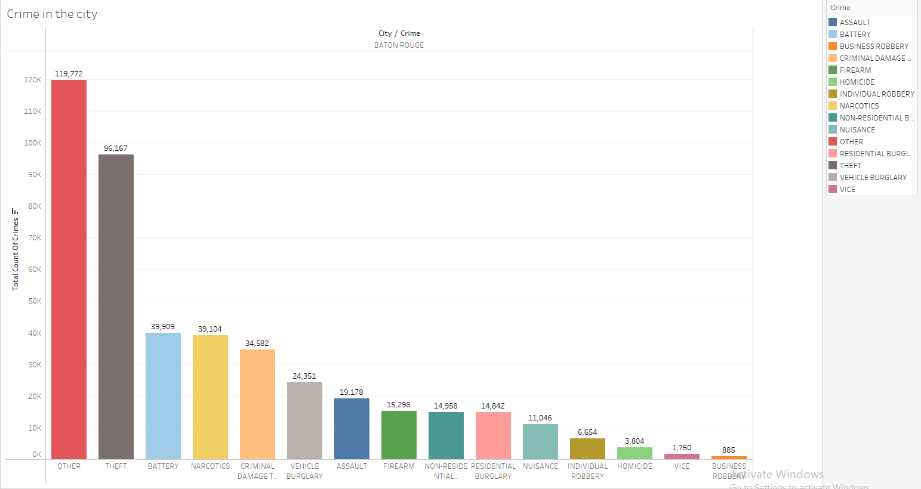
CRIME DISTRIBUTION IN THE BATON ROUGE CITY
This distribution shows the count of the crimes happening in the city, Other with count 119,772 has the highest count following with Theft with the count of 96,167.

Slide 3
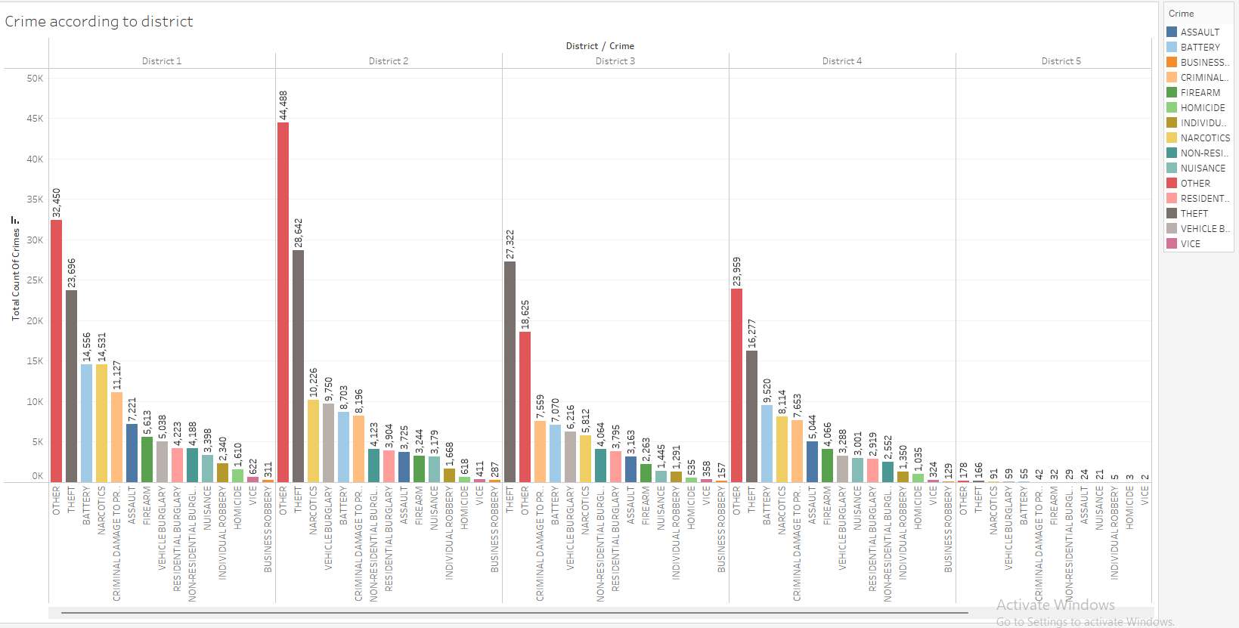
CRIME DISTRIBUTION DISTRICT WISE
This distribution is showing District 2 has the highest crime occurring which Is the other type with 44,488 count of crime, second highest district is District 1

Slide 4
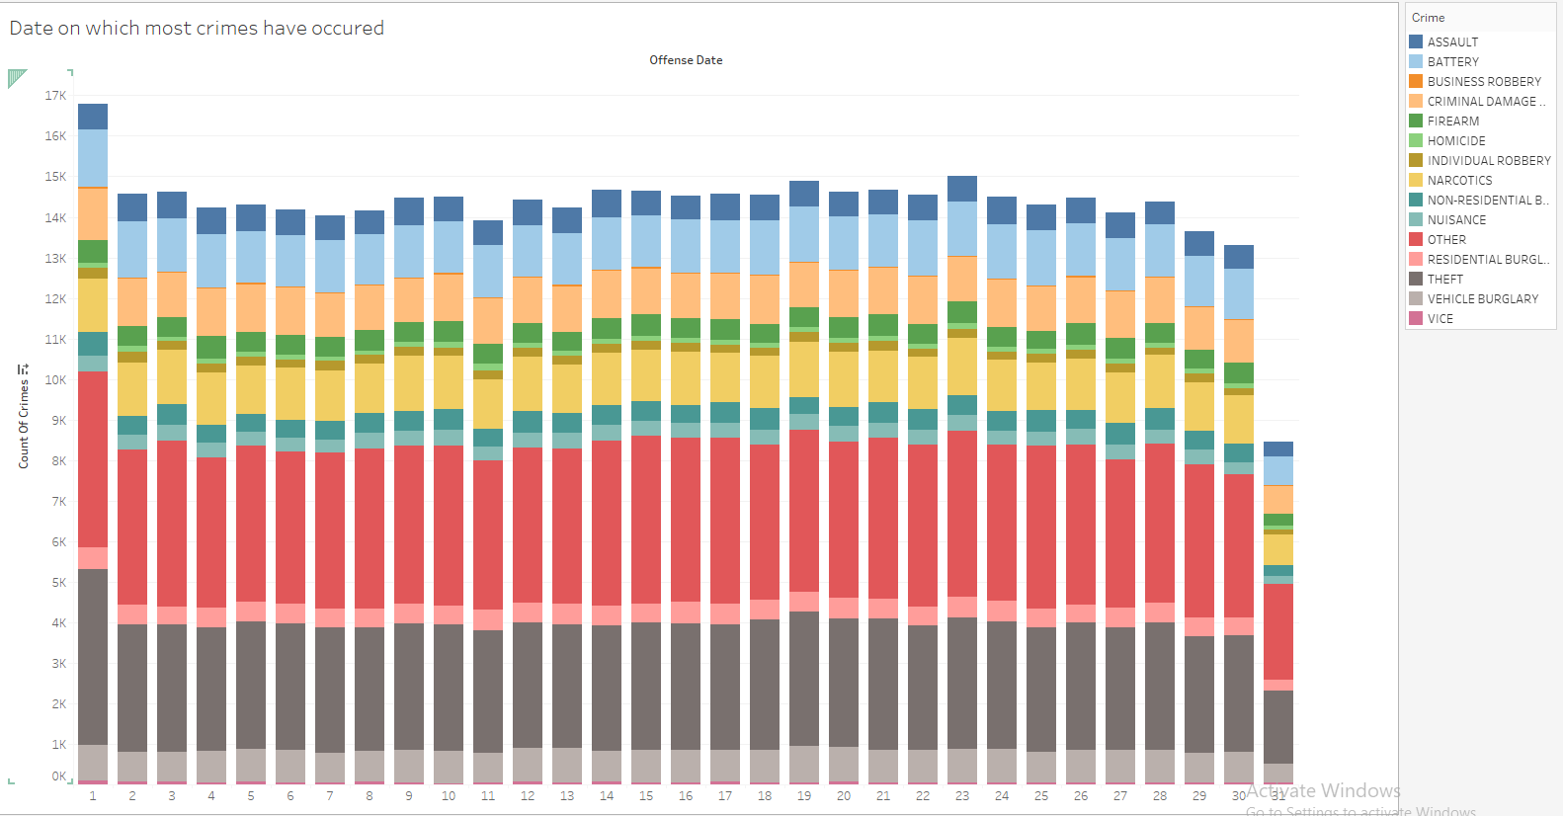
DATES WITH MOST CRIME
As we can see in the distribution among all the dates from the month of all the years date 1 has most crime occurred and the lowest is the date 31.

Slide 5
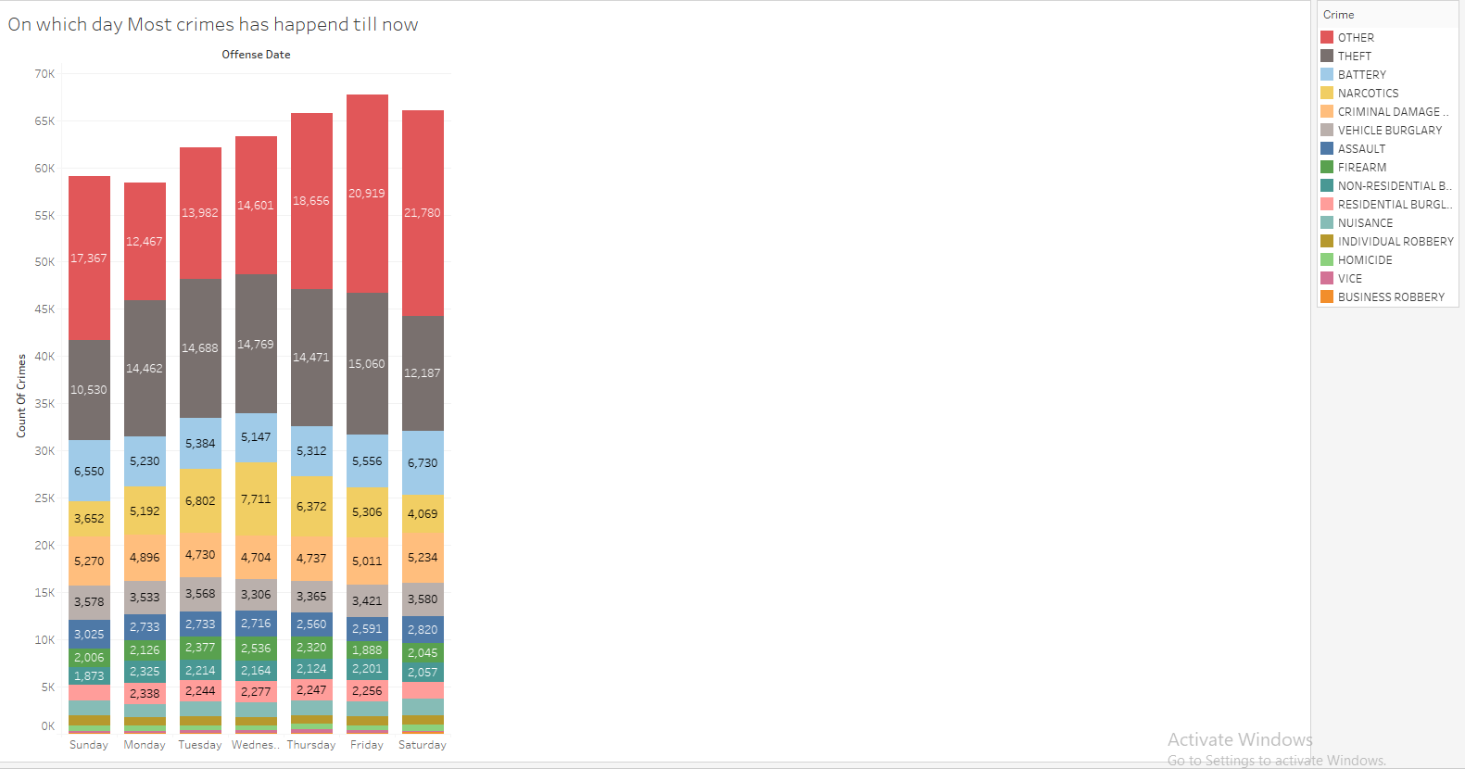
On which weekday the most crime has happened?
Distribution says that most of the crimes has happened on the day of Friday, following with Saturday, also theft and other types of crime are the most common occurring crimes.

Slide 6
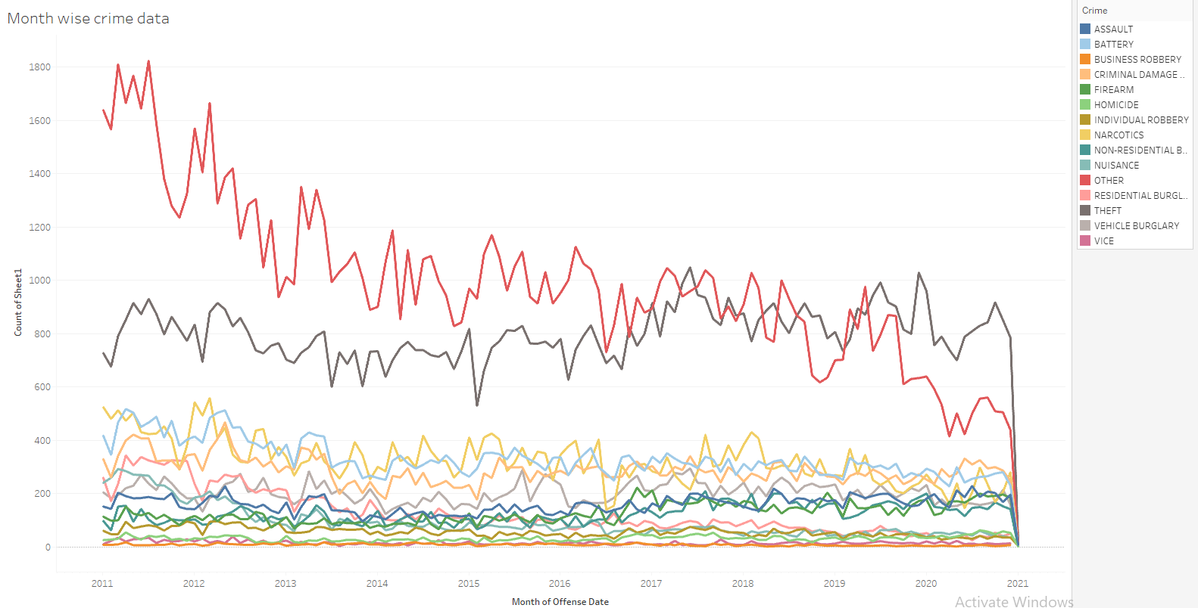
Month Wise Crime Data
According to the distribution Other type of crime has happened the most in year of july,2011 with 1824 crimes reported In that year. Theft has reported the most in the year of June 2017 with 1049 records.

Slide 7
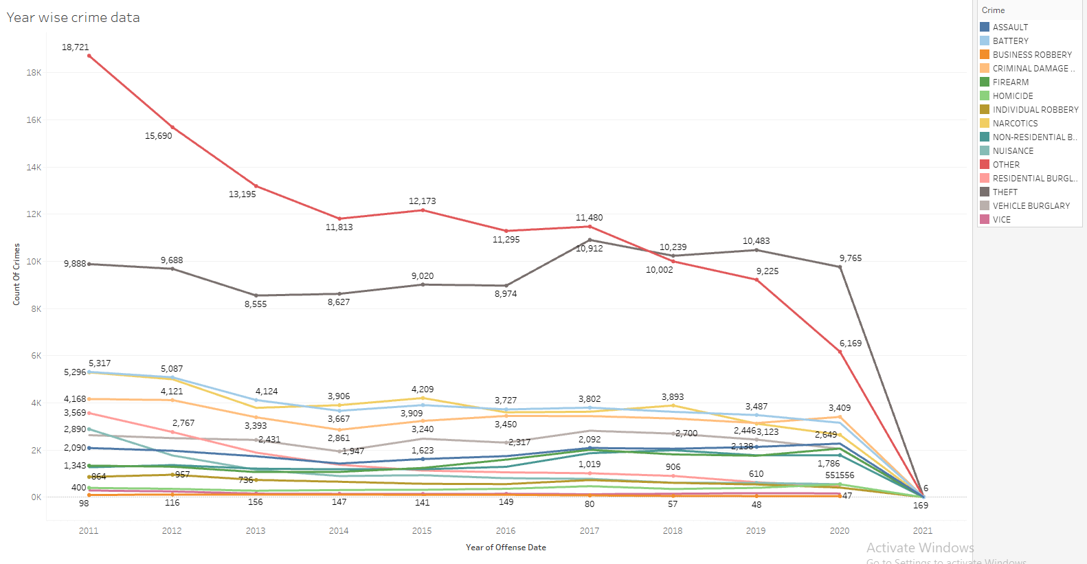
Year Wise Crime Data
Crime rate was high in the year of 2011 but as we can see from this plot that the crime rate has decreased gradually year by year, so in the year 2021 crimes has been reported much less as compared to 2011. Till 2020 other than crime type ‘Other’ and ‘Theft’ the trend has been almost same for all the years .

Slide 8
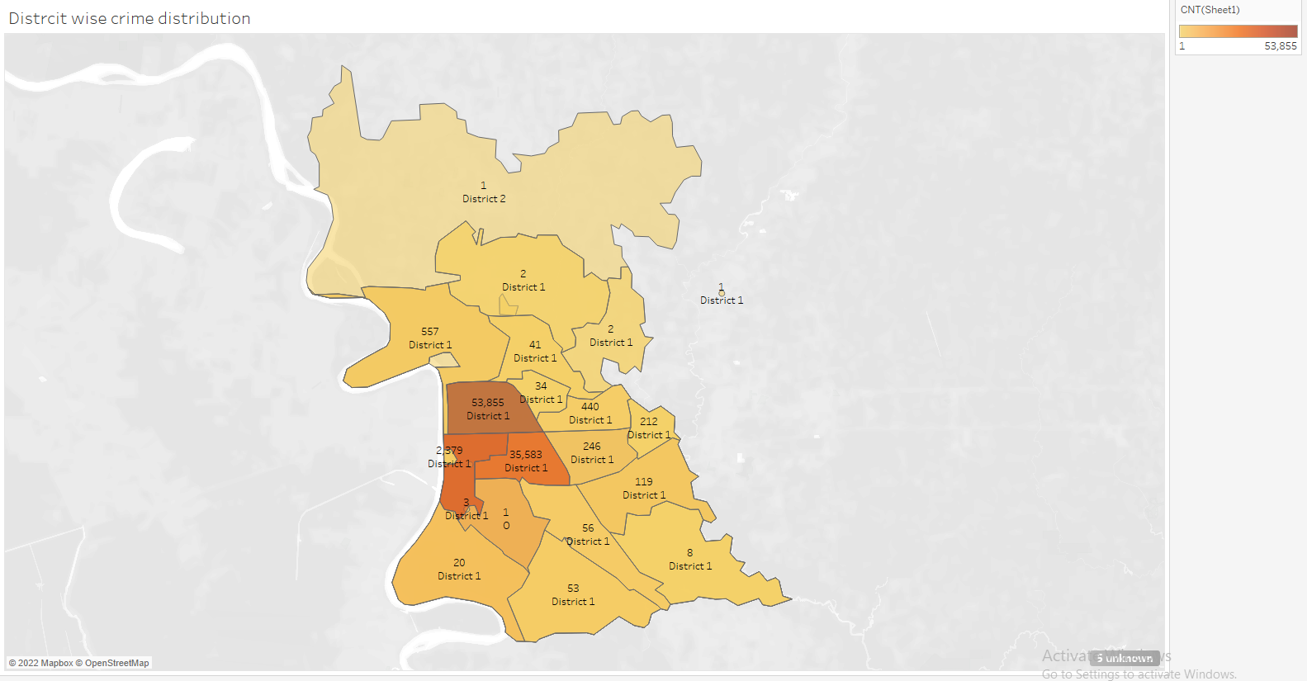
District wise crime Distribution
In this geographical distribution most of the crimes has happened area of District 1 among which highest is the 53,855.

Slide 9
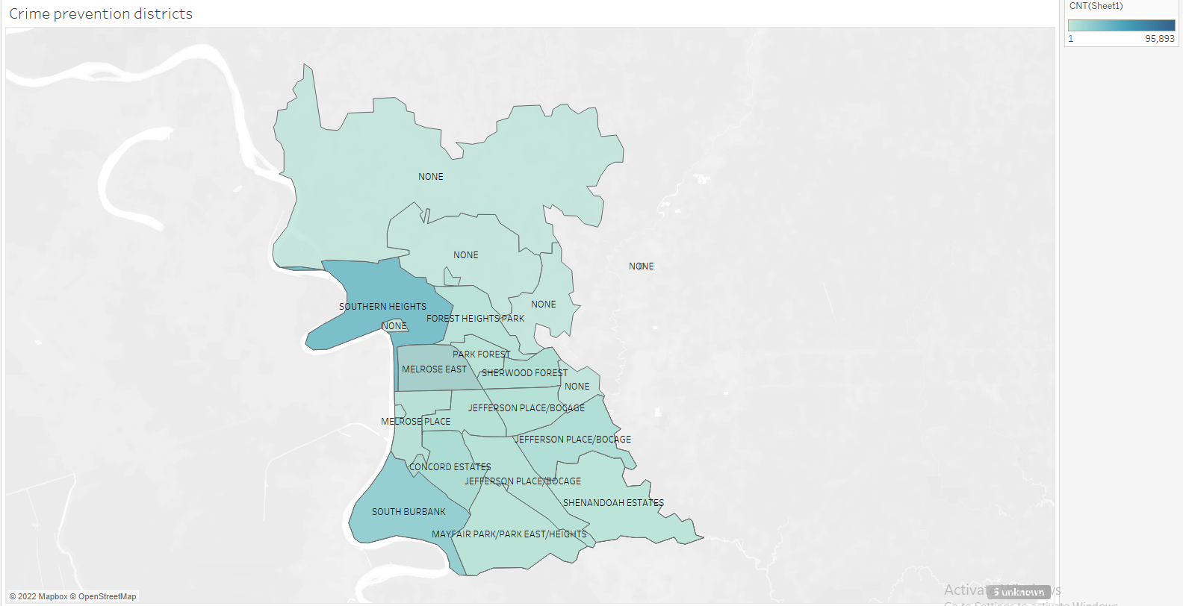
CRIME PREVENTION DISTRICTS IN BATON ROUGE CITY

Slide 10
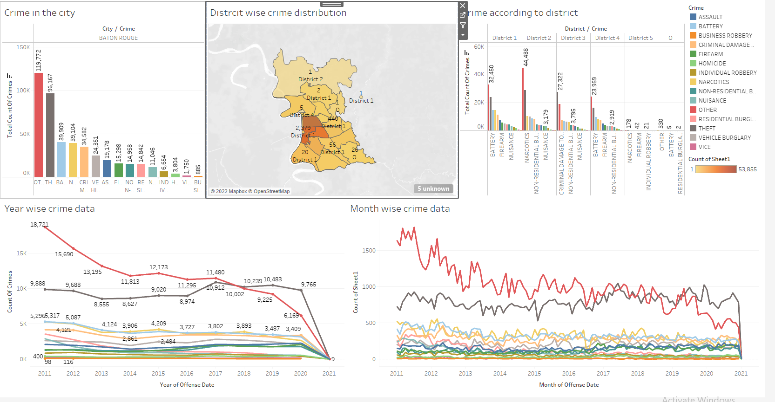
DASHBOARD

Slide 11
CONCLUSION
Other and theft are by far the most common type of serious crime happened in the past years in Baton Rouge City. Serious crimes are most likely to occur on Friday and least likely to occur on Modnay. Serious crimes are most common in the District 2.
It is possible to predict where or when the crime will be committed with the help of time series and other Machine Learning predication methods.
Officers and investigators should more focus on crimes like Theft and the other categories which are not included more, primarily in District 2.Narcotics, Criminal Damage to Property and Battery come sto the next priority. Also officers should deploy checkpoints in the major crime districts, streets and areas on frdiay as major number of crimes are happening on friday.

